Slide 1

Visualizing World Economic Trends
UC Berkeley Extension Data Analytics
Liza Hartlaub, Marlon Schieber, Paul Song, Ray Zhang

Slide 2

United Nations Country Data
Summary of the data
Data Sets Used: United Nations Country Statistics, 20 international statistical sources compiled by the Statistics Division and the Population Division of the United Nations, from the year 2017.
country_profile_variables.csv [Columns:47 economic indicators such as: health, education, technology, CO2 emissions, etc.
country_profile_variables.csv [Rows:229 Countries]

Slide 3

Key Questions
Which regions of the world have the highest economic impact and highest growth forecast?
How does economic success affect unemployment and population growth within different economic sectors, such as the agriculture, industry, or service sectors?
Does economic success affect life expectancy, and if so, how effective is GDP investment into healthcare?
Is there a correlation between a country’s economic success and its technological and environmental indicators?

Slide 4



Python Libraries Utilized
import pandas as pd
import numpy as np
import matplotlib.pyplot as plt
import csv
import os

Slide 5
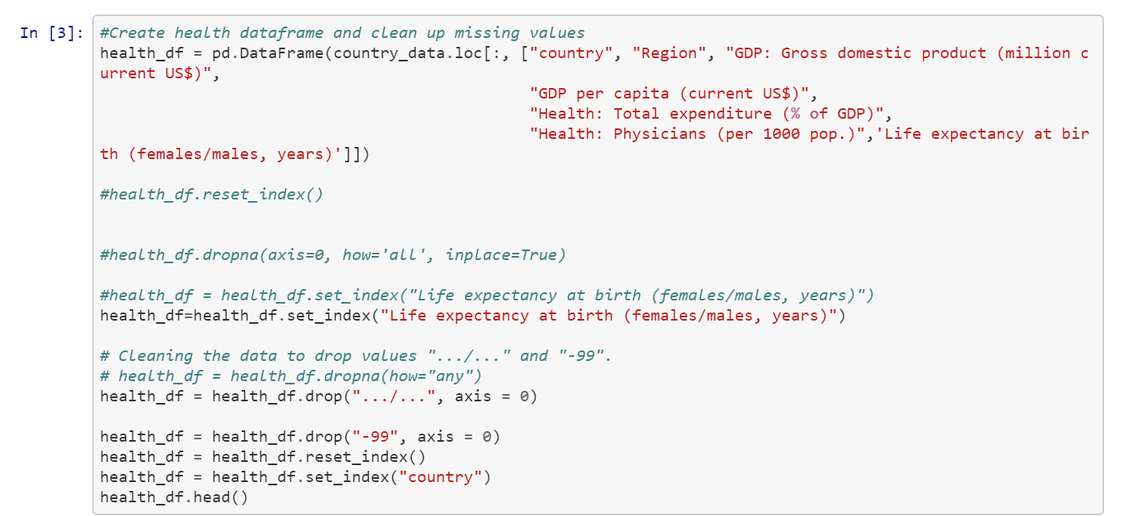
Data Cleaning Code Snip

Slide 6

Global economic fundamentals
Which regions of the world have the highest economic impact?
Which regions have the highest growth forecast?
How does economic size affect the unemployment rate?
How do different industries of an economy affect urban population growth?

Slide 7
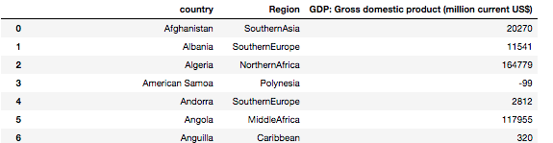
Cleaning data
# change values to numeric
country_region_gdp_df.loc[:,'GDP: Gross domestic product (million current US$)'] =
pd.to_numeric(country_region_gdp_df.loc[:,'GDP: Gross domestic product (million current US$)'], downcast='integer')
# check data types
country_region_gdp_df['GDP: Gross domestic product (million current US$)'].dtypes
#remove the -99 values
country_region_gdp_df = country_region_gdp_df[country_region_gdp_df['GDP: Gross domestic product (million current US$)'] != -99]

Slide 8
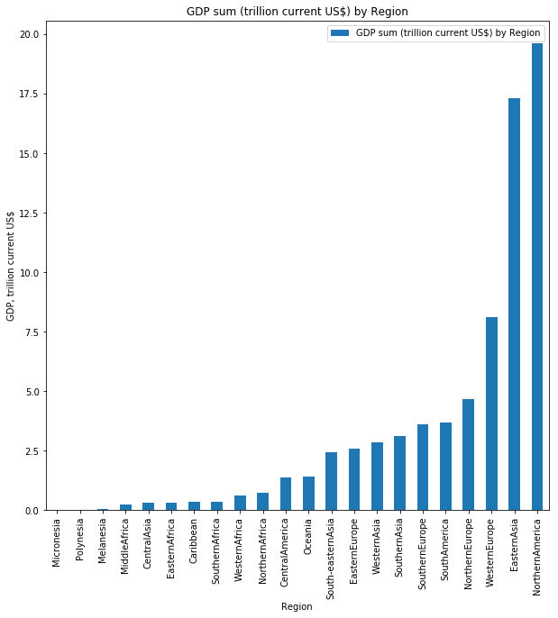
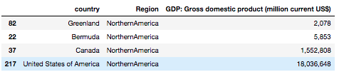
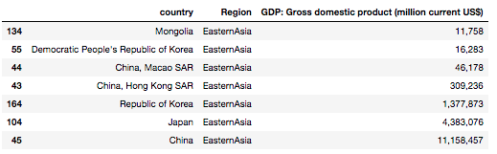
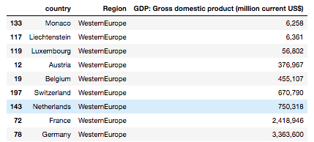
GDP total by Region

Slide 9
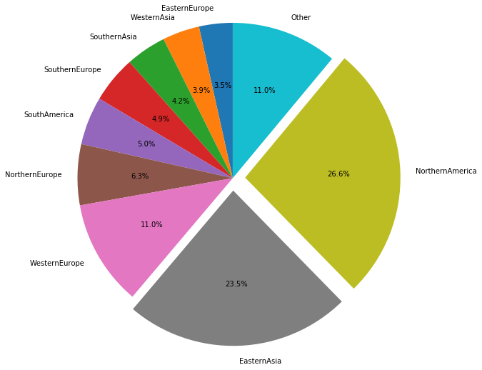
Percentage of Global GDP by Region
50% of global GDP output, is found in two regions alone

